Slide 1


YOU LOOK ONLY ONCE (YOLO) A Hands-on Introduction to the State of the Art Realtime Object Detection Deep Learning Model
Bradley Erickson
MD PhD
Pouria Rouzrokh MD MPH MHPE
Radiology Informatics Laboratory Mayo Clinic

Slide 2
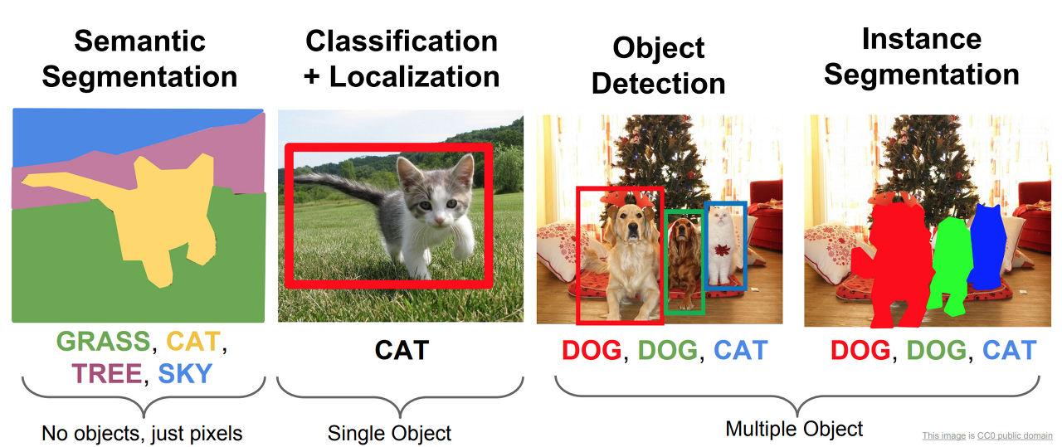
Defining Object Detection

Slide 3
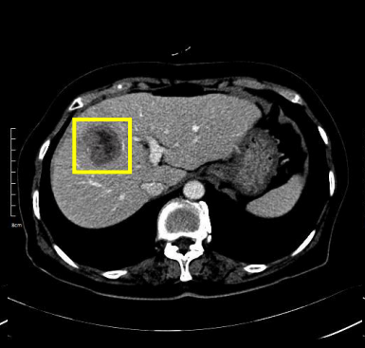
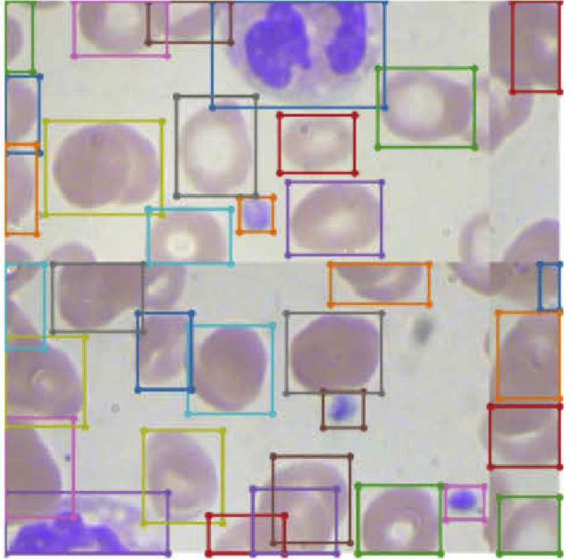
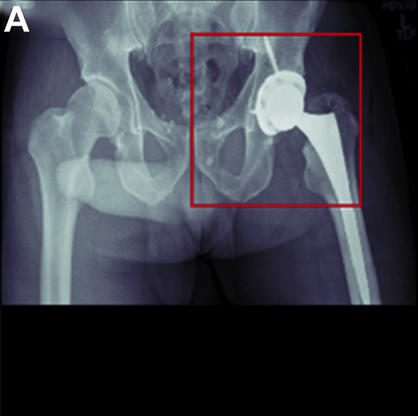
Medical Applications of Object Detection
Sources:
Liver Lesion Detection from Weakly-labeled Multi-phase CT Volumes with a Grouped Single Shot MultiBox Detector
Improved detection performance in blood cell count by an attention-guided deep learning method
Deep Learning Artificial Intelligence Model for Assessment of Hip Dislocation Risk Following Primary Total Hip Arthroplasty From Postoperative Radiographs

Slide 4
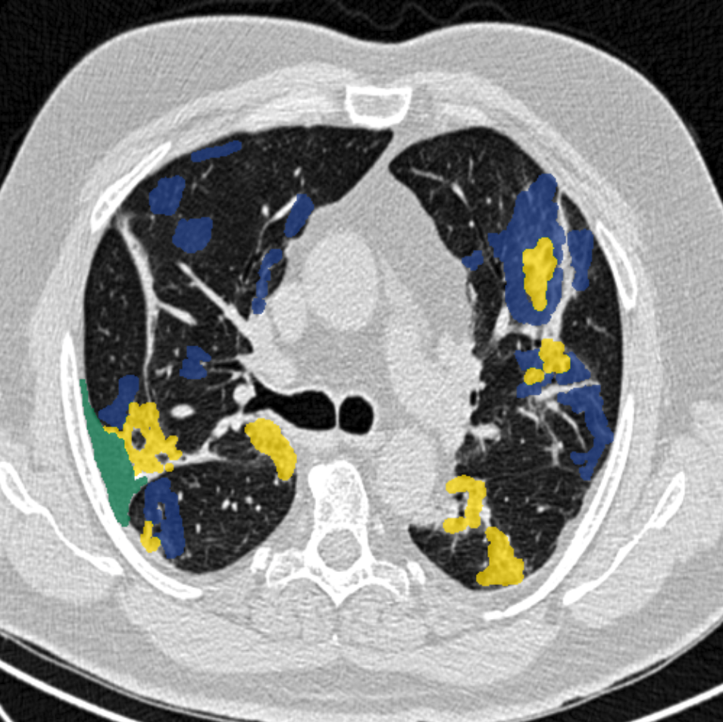
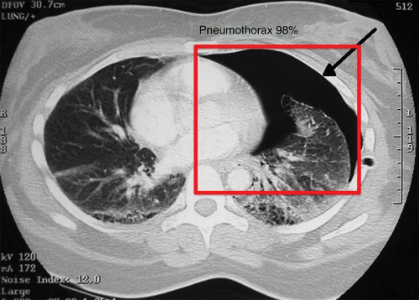
Object Detection vs. Object Segmentation
Object Detection | Semantic Segmentation
Does patch (bounding box)-level predictions. | Does pixel-level prediction.
Does not identify the objects’ borders or volumes. | Can identify the exact border (and volume) of an object.
Less tedious manual labeling: Simply draw a bounding box! | More tedious manual labeling: Manually segment each pixel of interest!

Slide 5
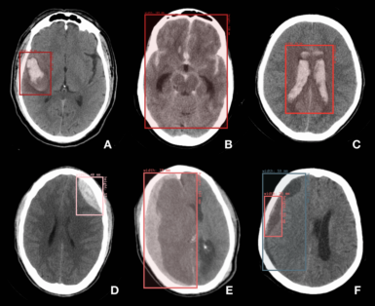
What We Do Today!
To train a deep learning model to
detect brain hemorrhage lesion on Head CT scans!
For our data, we use the publicly available CQ500 Head CT-scan dataset of patients with brain hemorrhage.
For our labels, we use the bounding box annotation on CQ500 dataset by Physionet.

Slide 6
Our Notebook Workflow
Part 0: Setting up the working directory
Part 1: Extracting CT images
Part 2: Collecting and visualizing the annotated bounding box labels
Part 3: Data splitting and setting up the training and validation sets
Part 4: Downloading the YOLO model and configuring it
Part 5: View and modify the hyperparameters (optional)
Part 6: Training
Part 7: Inference
80% of code!
20% of code!

Slide 7
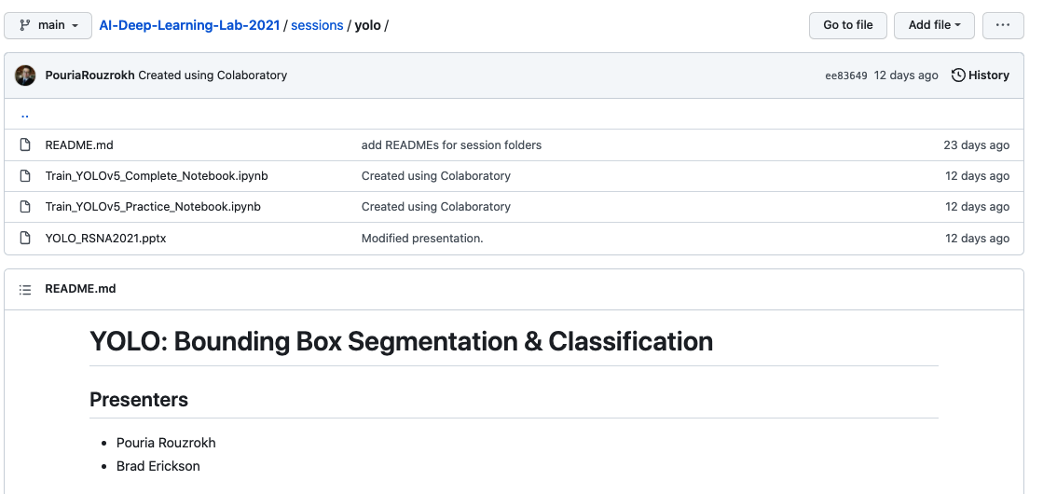
Let’s Run Our Notebook! (1)
https://github.com/RSNA/AI-Deep-Learning-Lab-2021/tree/main/sessions/yolo

Slide 8
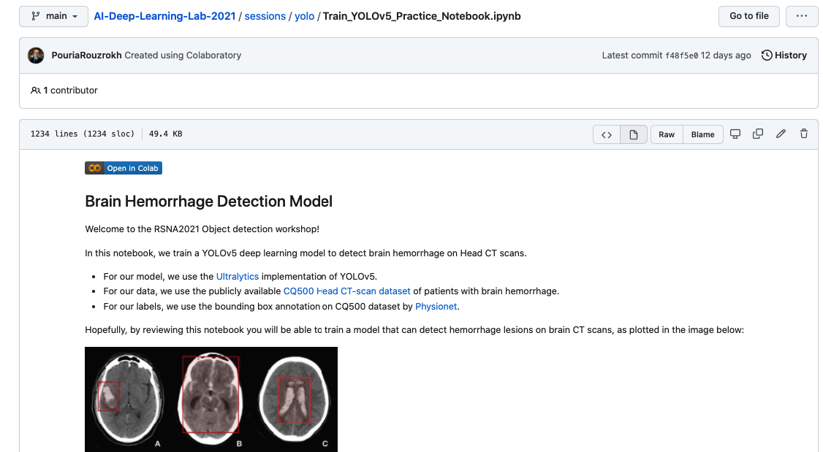
Let’s Run Our Notebook! (2)

Slide 9
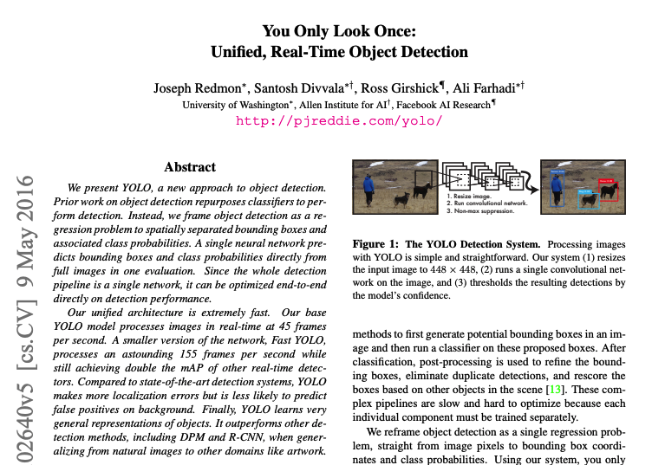
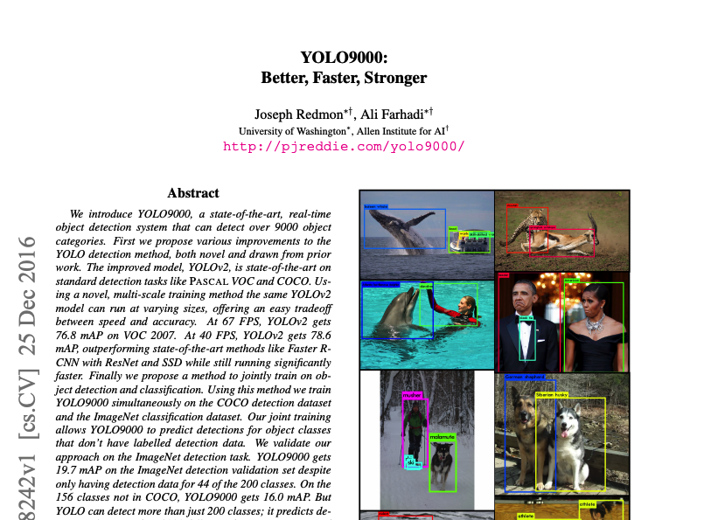
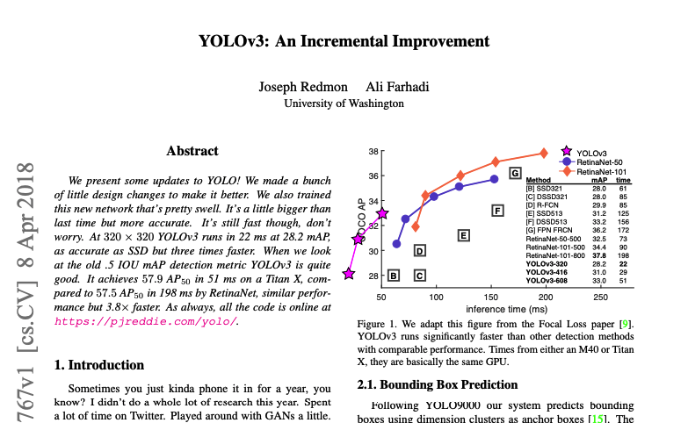
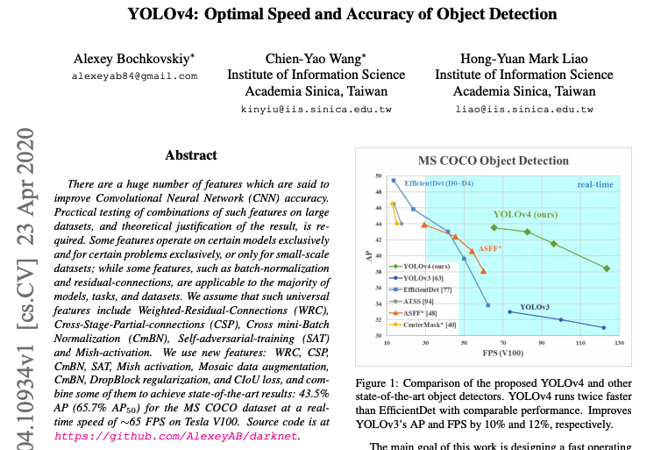
You Look Only Once (YOLO)

Slide 10
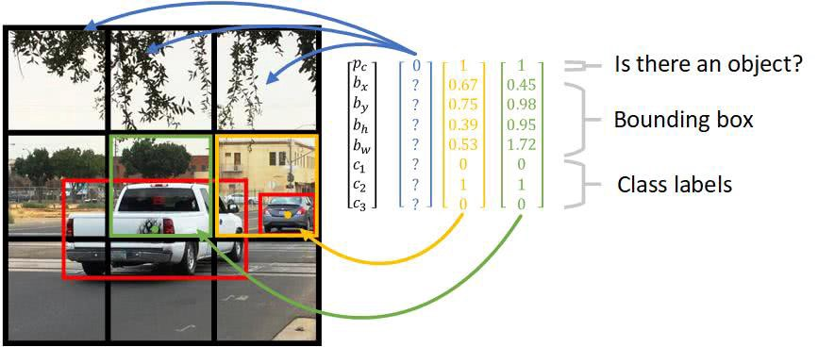
How YOLO Works (1)
Source:
https://stackoverflow.com/questions/50575301/yolo-object-detection-how-does-the-algorithm-predict-bounding-boxes-larger-than

Slide 11
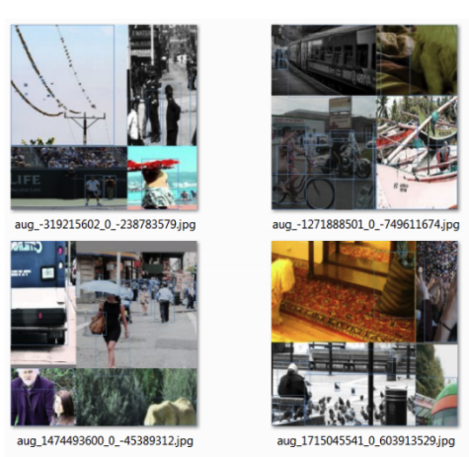
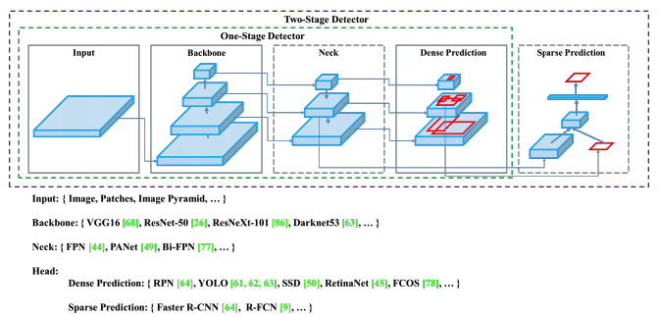
How YOLO Works (2)
Note: New versions of YOLO use advanced architectures, data augmentation techniques, and training strategies! Please refer to their papers for understanding the novelties.

Slide 12
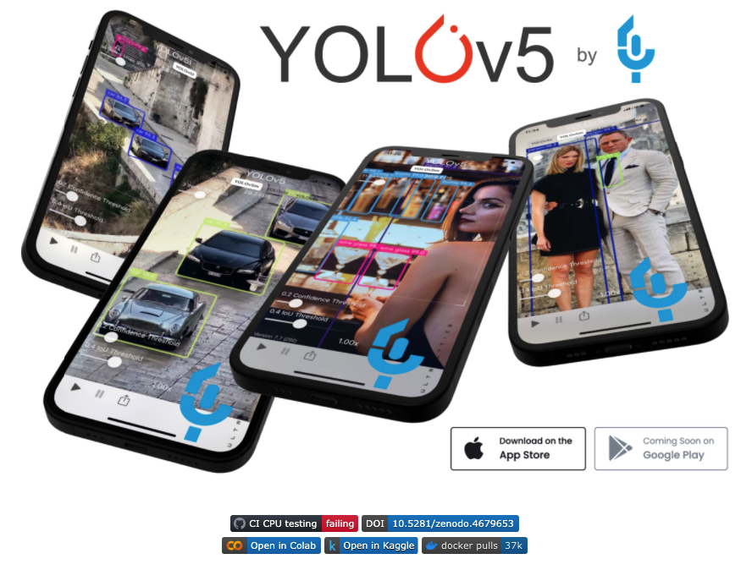
YOLOv5
One of the latest versions of YOLO.
No scientific manuscript released yet.
Based on YOLOv4 + some technical improvements.
Based on Pytorch (as opposed to Darknet), and therefore significantly smaller than YOLOv4.
Easy implementation for custom training and helpful documentation/ tutorials by Ultralytics.

Slide 13
Big Picture of Training a YOLOv5 Model
Ultralytics has implemented YOLOv5 as a ready to train package, i.e., training and inference with it take only 1 to 2 lines of code!
However, most of your time will be spent on collecting and organizing your data as YOLOv5 expects it to be.
When your data is ready, you should clone the YOLOv5 model directory from the Ultralytics GitHub page, and then configure it to know your data.
You can select different size variants of YOLOv5, with or without transfer learning from the models trained on ImageNet.

Slide 14
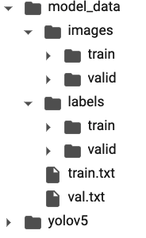
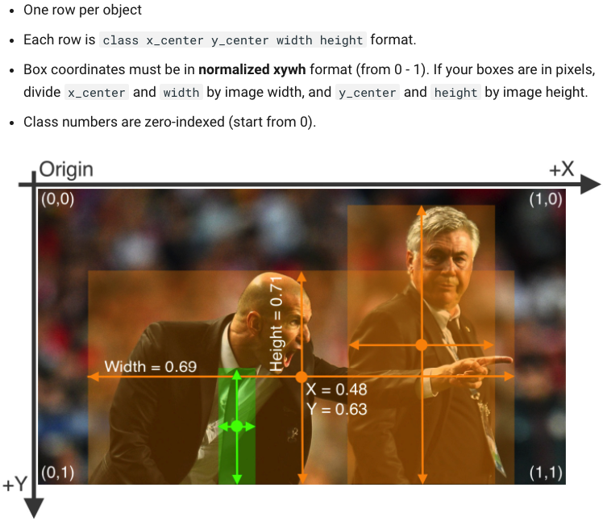
Data Organization
Image1.png
Image2.png
…
Image1.txt
Image2.txt
…
Each file
Path to image1.png
Path to image2.png
…

Slide 15
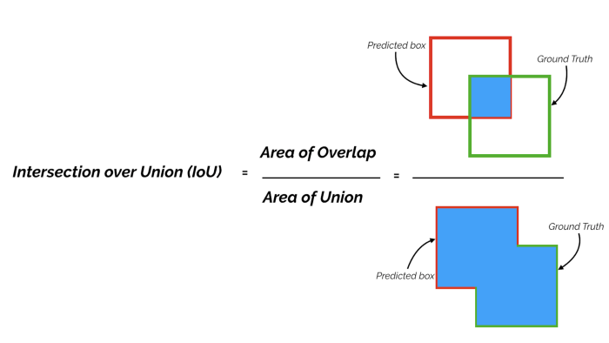
Intersection over Union (IOU)
Source: https://towardsdatascience.com/map-mean-average-precision-might-confuse-you-5956f1bfa9e2

Slide 16
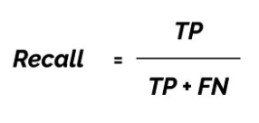
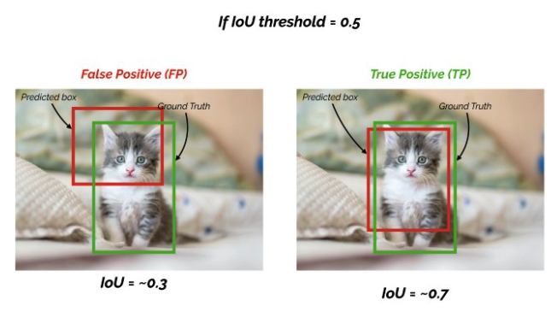
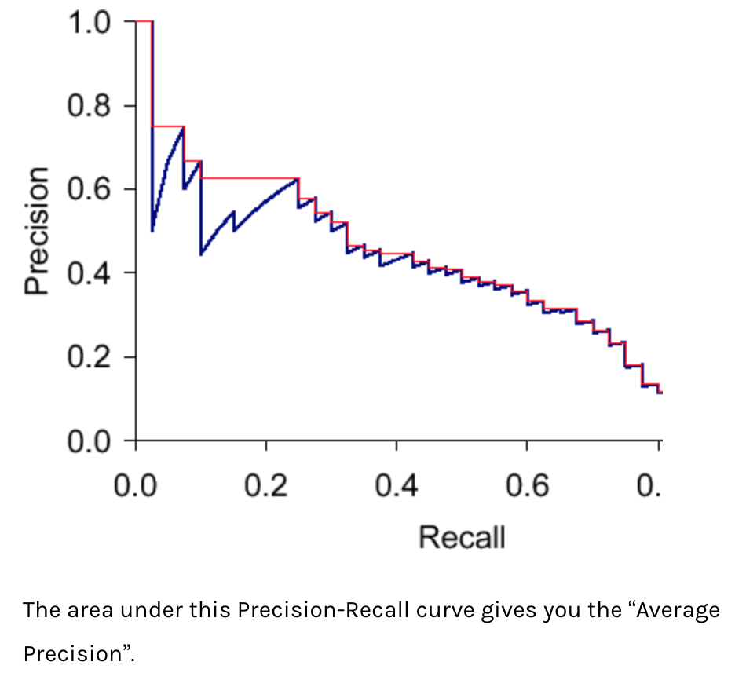
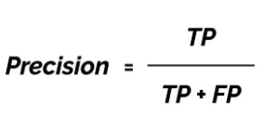
Mean Average Precision (mAP)
The area under the Precision-Recall curve for an object detection model is called the “Average Precision” of that model. If you take the mean of these “Average Precision” scores across all classes which the model predicts, you will achieve a metric for evaluating your model: mean Average Precision (mAP)!

Slide 17
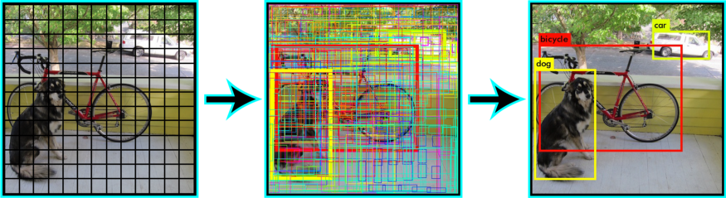
Non-max Suppression
Non-Max Suppression:
To select the best bounding box, from the multiple predicted bounding boxes, these object detection algorithms use non-max suppression.
In this technique, if two bounding boxes have an IoU over a certain threshold (e.g., 60%), the bounding box with the lower confidence score will be discarded.
Source: https://www.pyimagesearch.com/2018/11/12/yolo-object-detection-with-opencv/

Slide 18
Thank you for your attention!

